Slide 1

Dishank Hanwate(26)
Sakshi Nagavkar(59)
Malay Mestry(52)
Disha Jain(29)
Bhakti Budar(7)

Slide 2
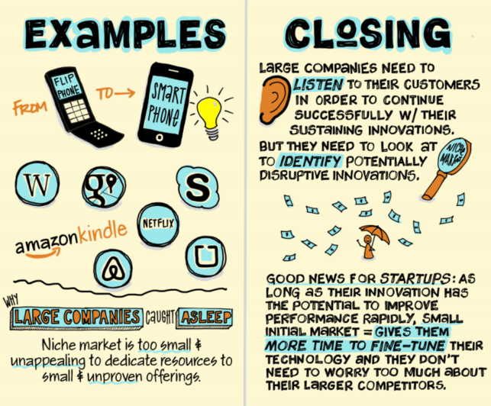
What is Disruptive Innovation?

Slide 3
4 TIPS FOR UNDERSTANDING THE THEORY OF DISRUPTIVE INNOVATION
Not All Innovation Is Disruption
Disruption Can Be Low-End or New-Market
Disruptive Innovation Is a Process, Rather Than a Product or Service
Choose Your Battles Wisely

Slide 4



What makes a successful Disruptive Innovation?
Enabling Technology
Innovative Business Model
Coherent Value Network

Slide 5
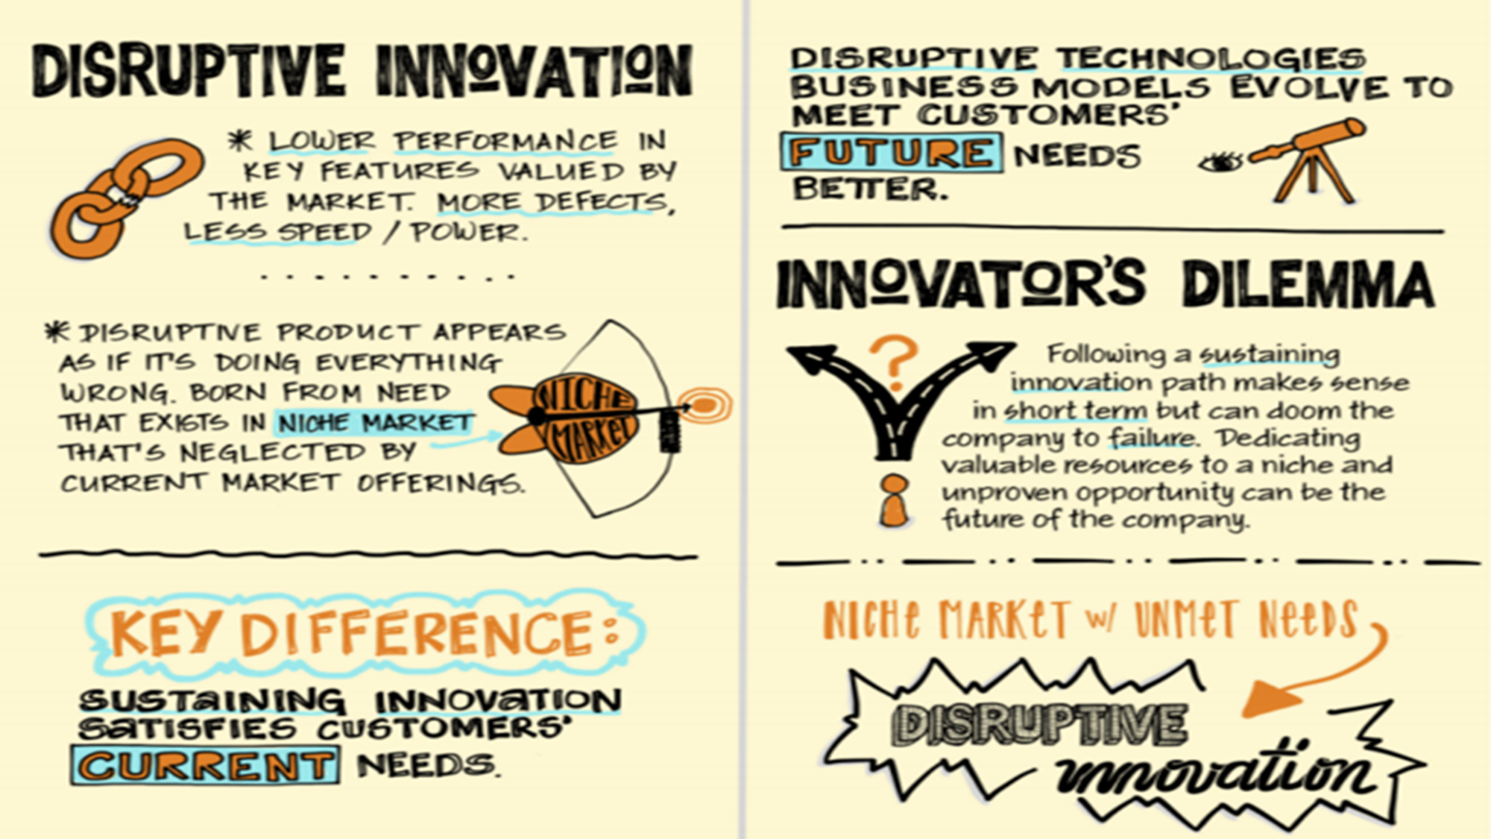
How to distinguish a disruptive innovation?

Slide 6



Why it Matters?
Healthcare
Economic growth
Education

